Slide 1


Igor Andrade
June 2025

Slide 2

Outline
Executive Summary
Introduction
Methodology
Results
Conclusion
Appendix

Slide 3
Executive Summary
Summary of methodologies
Data collection
Data wrangling
Exploratory Data Analysis with Data Visualization
Exploratory Data Analysis with SQL
Building an interactive map with Folium
Building a Dashboard with Plotly Dash
Predictive analysis (Classification)
Summary of all results
Exploratory Data Analysis results
Interactive analytics demo in screenshots
Predictive analysis result

Slide 4
Introduction
Project background and context
SpaceX revolutionized commercial space travel by significantly reducing launch costs, mainly through reusing Falcon 9’s first stage. While traditional providers charge over $165M per launch, SpaceX offers the same for just $62M. Predicting whether the first stage will successfully land directly impacts cost estimation.
Problems you want to find answers
Analyze how payload mass, launch site, flight count, and orbit type influence landing success.
Examine trends in landing success over time.
Identify the most effective machine learning algorithm for predicting first stage landing outcomes.

Slide 5

Section 1

Slide 6
Methodology
Executive Summary
Data collection methodology:
Spacex API
Web Scrapping
Perform data wrangling
Clear data with Pandas
Perform exploratory data analysis (EDA) using visualization and SQL
Perform interactive visual analytics using Folium and Plotly Dash
Perform predictive analysis using classification models
Avaliate Logistic Regression, SVM, Decision Tree and K-Means

Slide 7
Data Collection
The data was collected via SpaceX API calls, with the Python requests library and Web Scrapping, using requests and BeaufiulSoup libraries.
For the SpaceX API provided the history of launches and its information;
The Web Scrapping was used to access the Falcon 9 Wiki page and get complementary information about the rockets.

Slide 8
Data Collection – SpaceX API
First, the rocket launch history was gathered by launches endpoint;
The rockets, launchpads, payloads, and cores data foreign keys from other endpoints, so helper functions were created to make these API calls and complete the data with meaningful content.
SpaceX API calls Notebook
Spacex API
launches
launches
rockets
launchpads
payloads
cores
launches
lunches

Slide 9
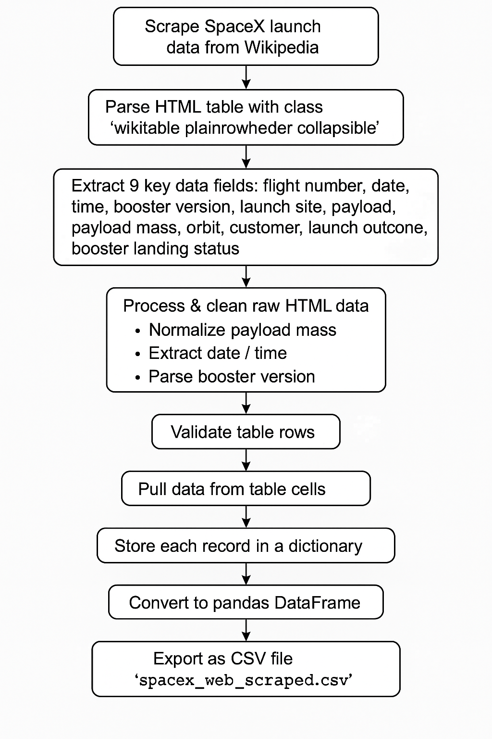
Data Collection - Scraping
The script scrapes SpaceX launch data from Wikipedia tables, validates rows by numeric flight numbers, and extracts 9 fields per launch using helper functions. It stores data in a dictionary structure and exports to CSV.
Scrapping Notebook

Slide 10
Data Wrangling
Data Loading: Load SpaceX dataset and display first rows.
Data Quality: Check missing values percentage and data types.
Exploratory Analysis: Examine launch sites, orbits, and landing outcomes.
Binary Classification: Map bad outcomes to 0 (failed) and others to 1 (success).
Results: Calculate success rate and export cleaned dataset.
Outcome: Transform raw data into binary classification format for ML.
Data Wranglign Notebook

Slide 11
EDA with Data Visualization
Setup: Import pandas, numpy, matplotlib, seaborn for analysis and plotting.
Data Loading: Download SpaceX dataset from URL and load into dataframe.
Flight Plots: Visualize payload vs flight number and launch sites vs flight number by success.
Site Analysis: Plot launch sites vs payload mass to identify success patterns.
Orbit Analysis: Create success rate bar chart by orbit and scatter plots of orbit relationships.
Time Analysis: Extract plot success rate trends over time.
Feature Engineering: Select features and apply one-hot encoding to categorical variables.
EDA with Visualization Notebook

Slide 12
EDA with SQL
Setup: Load SQL extension and connect to SQLite database.
Data Import: Load SpaceX CSV from URL into SQL table.
Basic Queries: Find distinct launch sites and filter by site patterns.
Aggregations: Sum NASA CRS payload and average F9 v1.1 payload.
Analysis: Find first successful landing and specific payload ranges.
Outcomes: Count mission outcomes and find maximum payload booster.
Temporal: Extract failure details by date and analyze landing outcomes.
Result: SQL exploration of SpaceX launch data patterns.
EDA with SQL Notebook

Slide 13
Build an Interactive Map with Folium
Map Objects Created:
Orange Circles (1500m radius) around each launch site
Orange Text Markers showing launch site names
Clustered Markers (green=success, red=failure) for all launches
Distance Markers showing KM to coastline, city, highways, railway
Polylines connecting launch sites to nearby landmarks
Purpose:
Circles & Site Markers: Identify launch locations
Color-coded Clusters: Visualize success/failure patterns
Distance Markers & Lines: Analyze proximity to infrastructure
Mouse Position: Enable precise coordinate analysis
Mouse Position Widget for coordinate trackingAdd the GitHub URL of your completed interactive map with Folium map, as an external reference and peer-review purpose
Map Notebook

Slide 14
Build a Dashboard with Plotly Dash
Dashboard Summary
Plots/Graphs:
Pie Chart - Success rates by site or aggregated across all sites
Scatter Plot - Payload mass vs success, colored by booster version
Interactive Components:
Site Dropdown - Filter by specific launch site or view all sites
Payload Range Slider - Filter data by payload mass (0-10,000 kg)
Purpose:
Pie Chart: Compare success rates between sites and overall performance
Scatter Plot: Analyze payload weight impact on success with booster technology context
Dropdown: Focus analysis on specific sites or view aggregate trends
Slider: Filter by payload ranges to identify weight-related success patterns
Dash Code

Slide 15
Predictive Analysis (Classification)
Data Prep:
Load features & target, apply StandardScaler, train/test split
Models & Hyperparameters:
Logistic Regression: C values, L2 penalty
SVM: Kernels, C, gamma parameters
Decision Tree: Criterion, depth, samples
KNN: Neighbors, algorithms, distance
Process:
GridSearchCV with 10-fold CV for each model
Evaluate with accuracy scores and confusion matrices
Result: Compare all models to select best performer for SpaceX landing predictionAdd the GitHub URL of your completed predictive analysis lab, as an external reference and peer-review purpose
Analysis Notebook

Slide 16

Section 2

Slide 17
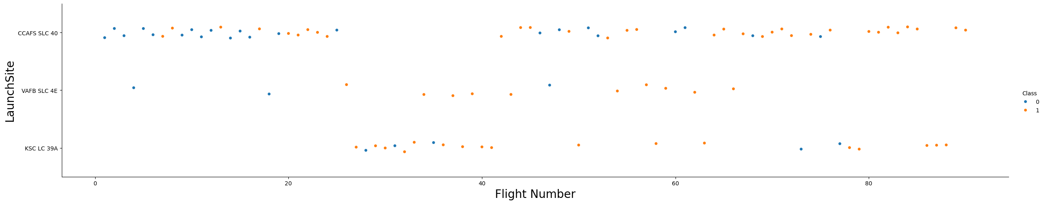
Flight Number vs. Launch Site
Chart demonstrates SpaceX's technological maturation from experimental failures to reliable operations, with newer facilities benefiting from accumulated knowledge and advanced systems.

Slide 18
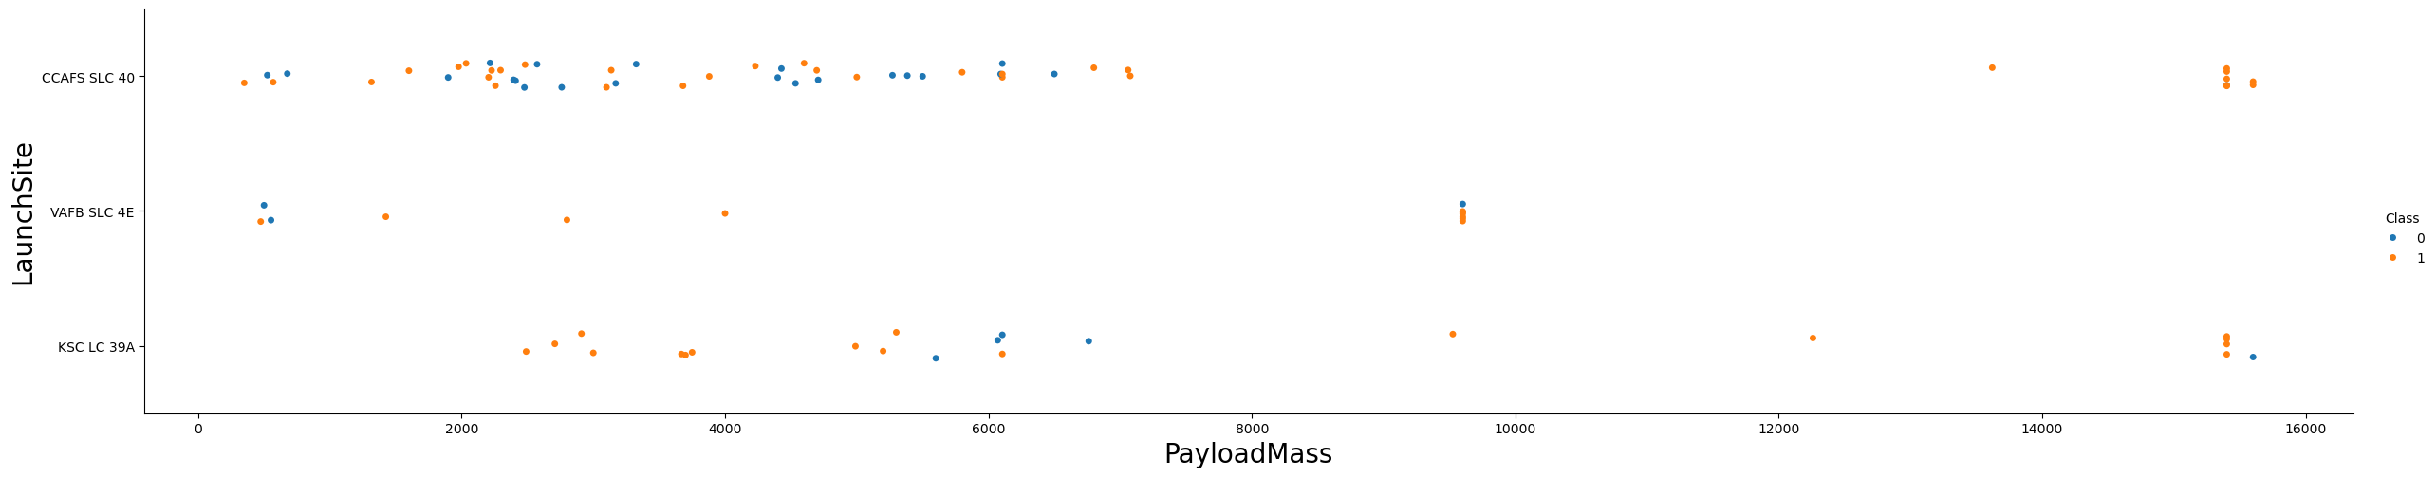
Payload vs. Launch Site
Different launch sites handle varying payload ranges, with KSC LC-39A typically managing heavier payloads and showing higher success rates, suggesting site-specific optimization.

Slide 19
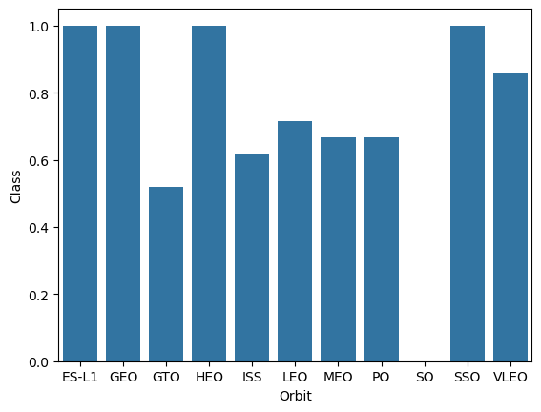
Success Rate vs. Orbit Type
Certain orbit types demonstrate significantly higher landing success rates, indicating that mission profile and orbital mechanics directly impact recovery feasibility.

Slide 20
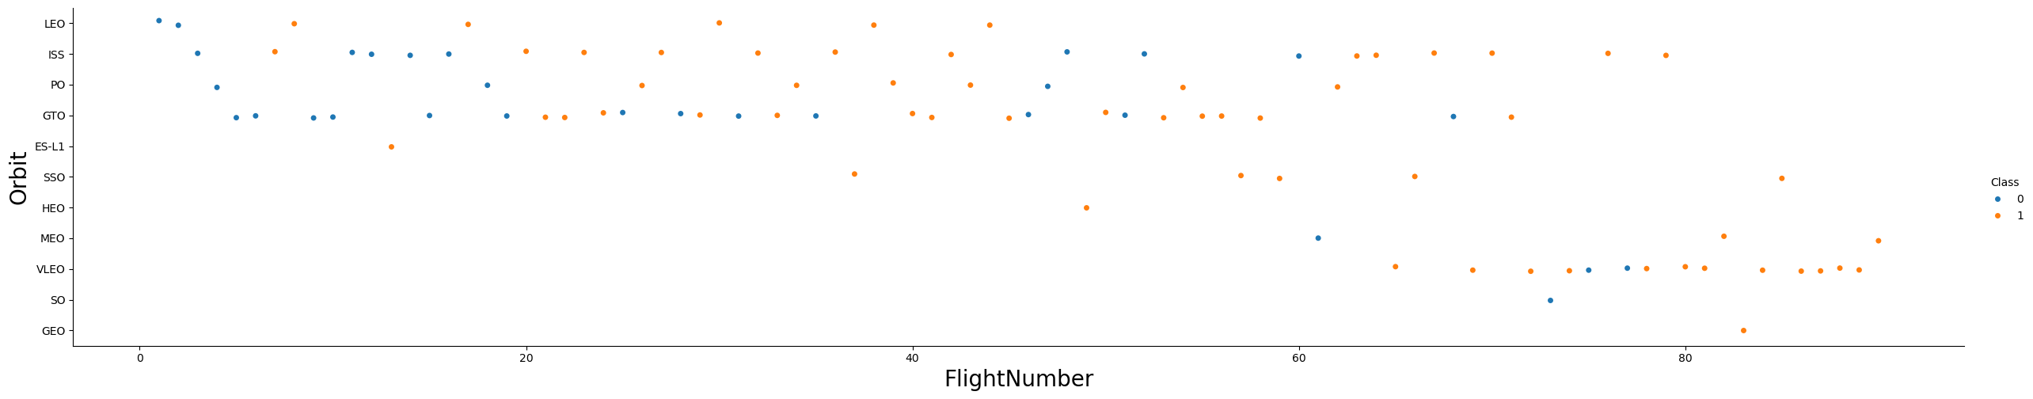
Flight Number vs. Orbit Type
Mission complexity and orbit selection evolved over time, with later flights targeting more diverse orbits while maintaining improved success rates through technological advancement.

Slide 21
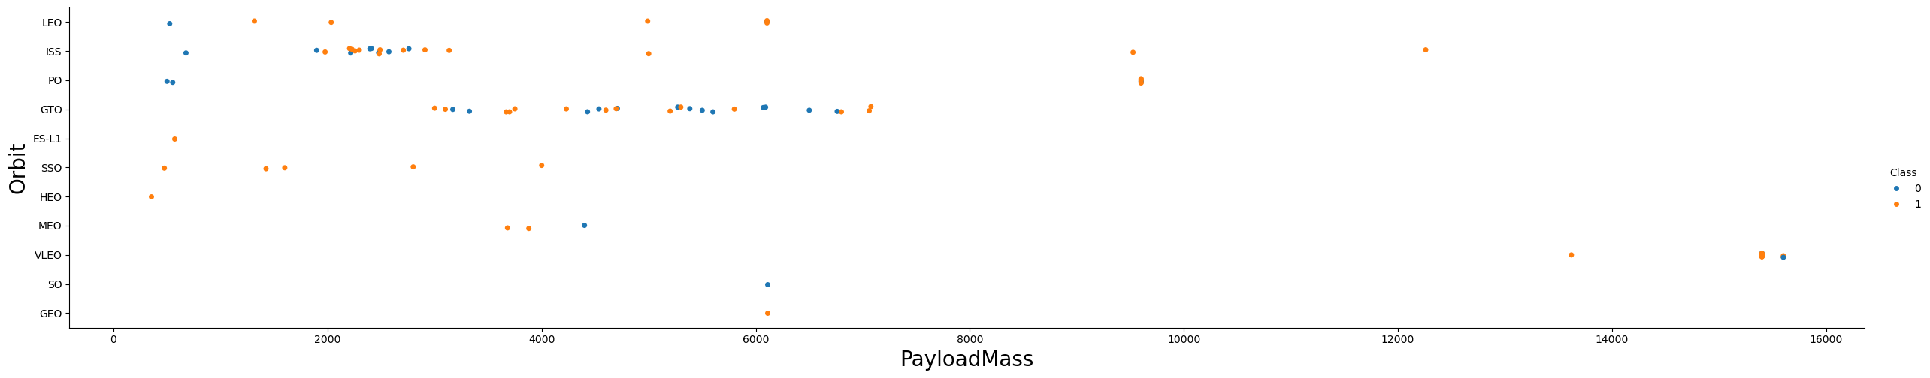
Payload vs. Orbit Type
Specific orbit-payload combinations show distinct success patterns, revealing optimal operational parameters for successful first-stage recovery based on mission requirements

Slide 22
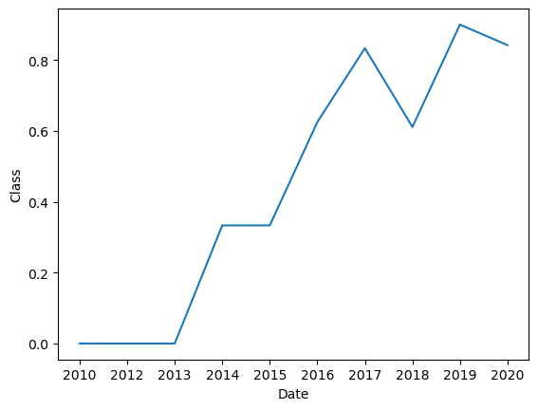
Launch Success Yearly Trend
Clear upward trend demonstrates SpaceX's rapid learning curve and systematic improvement, with success rates dramatically increasing from early experimental phases to current operational excellence.

Slide 23
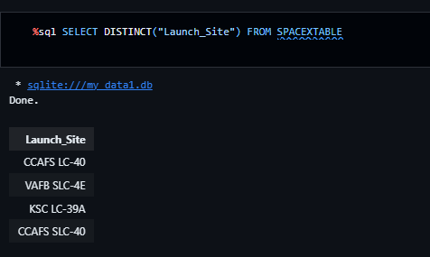
All Launch Site Names
The unique Launch Sites:
CCAFS SLC-40, KSC LC-39A, VAFB SLC-4E, CCAFS LC-40

Slide 24
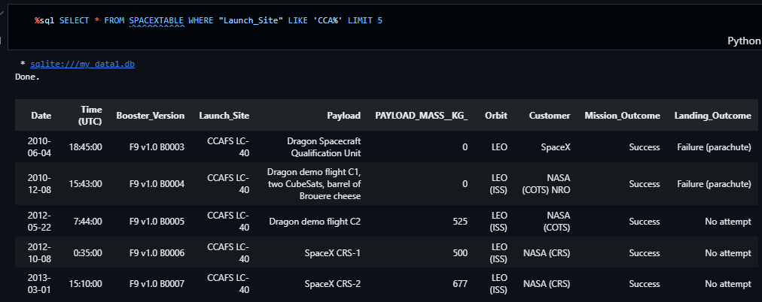
Launch Site Names Begin with 'CCA'
Find 5 records where launch sites begin with `CCA`

Slide 25
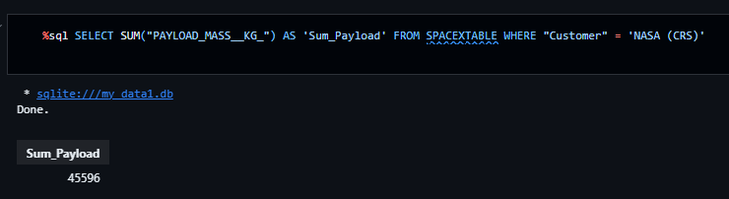
Total Payload Mass
Calculate the total payload carried by boosters from NASA

Slide 26
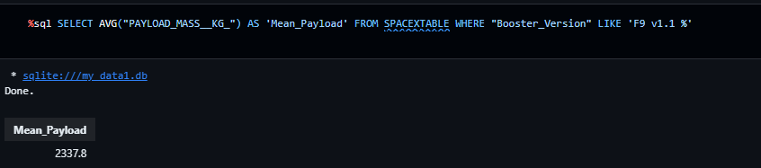
Average Payload Mass by F9 v1.1
Calculate the average payload mass carried by booster version F9 v1.1

Slide 27
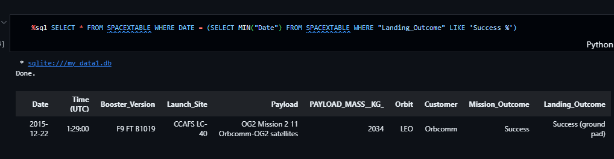
First Successful Ground Landing Date
Find the dates of the first successful landing outcome on ground pad

Slide 28
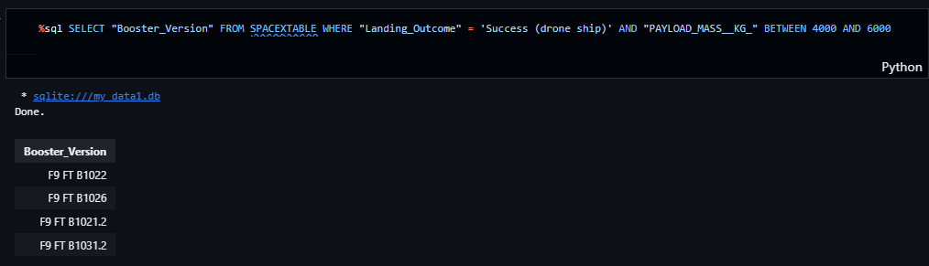
Successful Drone Ship Landing with Payload between 4000 and 6000
List the names of boosters which have successfully landed on drone ship and had payload mass greater than 4000 but less than 6000

Slide 29
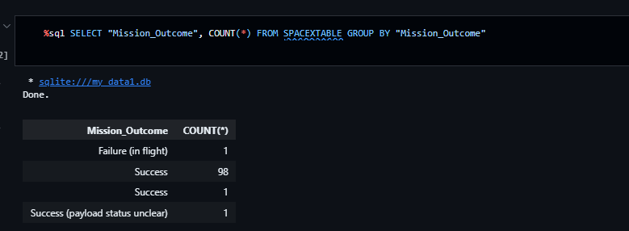
Total Number of Successful and Failure Mission Outcomes
Calculate the total number of successful and failure mission outcomes

Slide 30
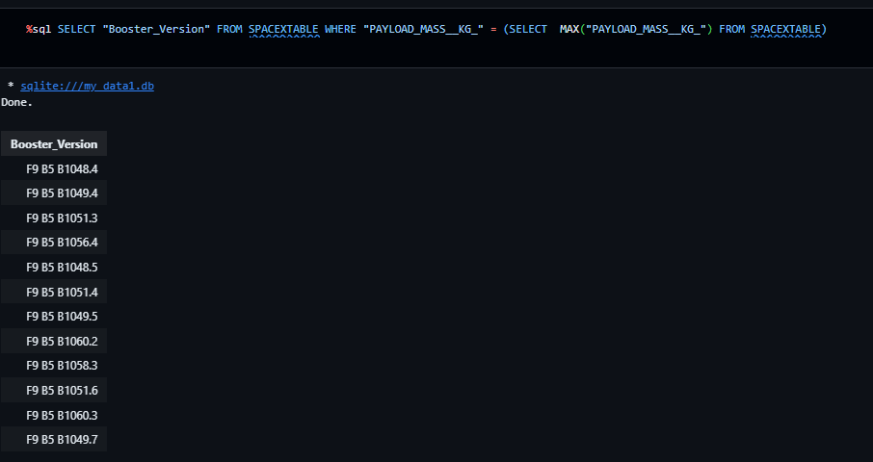
Boosters Carried Maximum Payload
List the names of the booster which have carried the maximum payload mass

Slide 31
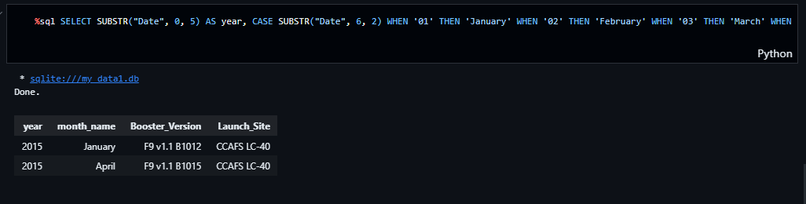
2015 Launch Records
List the failed landing_outcomes in drone ship, their booster versions, and launch site names for in year 2015

Slide 32
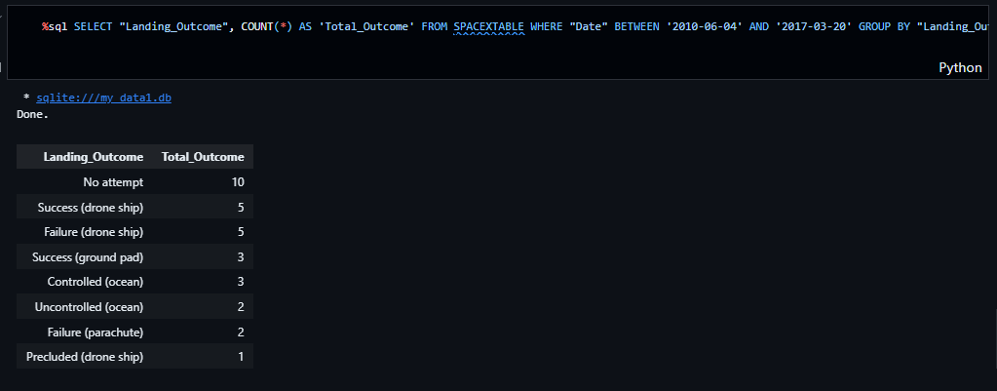
Rank Landing Outcomes Between 2010-06-04 and 2017-03-20
Rank the count of landing outcomes (such as Failure (drone ship) or Success (ground pad)) between the date 2010-06-04 and 2017-03-20, in descending order

Slide 33

Section 3

Slide 34
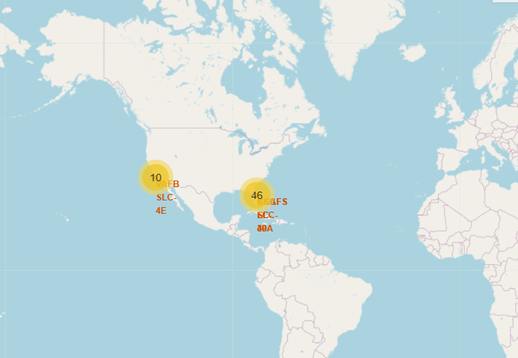
All launch sites’ location markers on a global map
Launch sites are near the equator, where Earth's rotation boosts rocket speed by 1670 km/h due to inertia.
Equatorial speed helps spacecraft maintain necessary orbital velocity after launch, making launches more energy-efficient.
Coastal launch sites reduce risk by ensuring rocket debris falls safely over the ocean, away from populated areas.

Slide 35
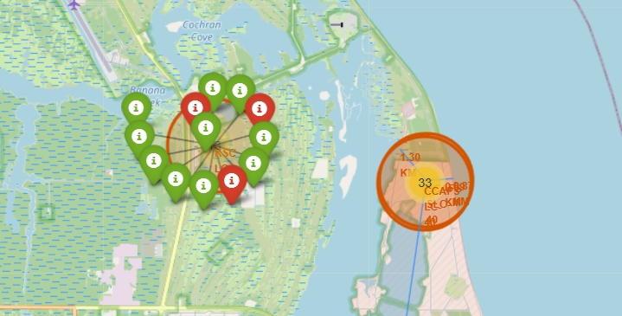
Colour-labeled launch records
Green markers show success; red markers indicate launch failure for quick visual comparison.
Colors help identify reliable launch sites easily.

Slide 36
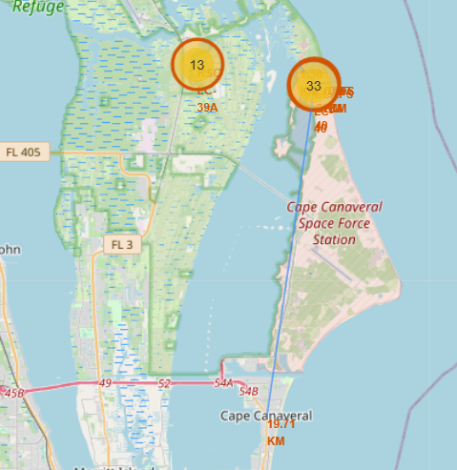
Distance from the launch site

Slide 37

Section 4

Slide 38
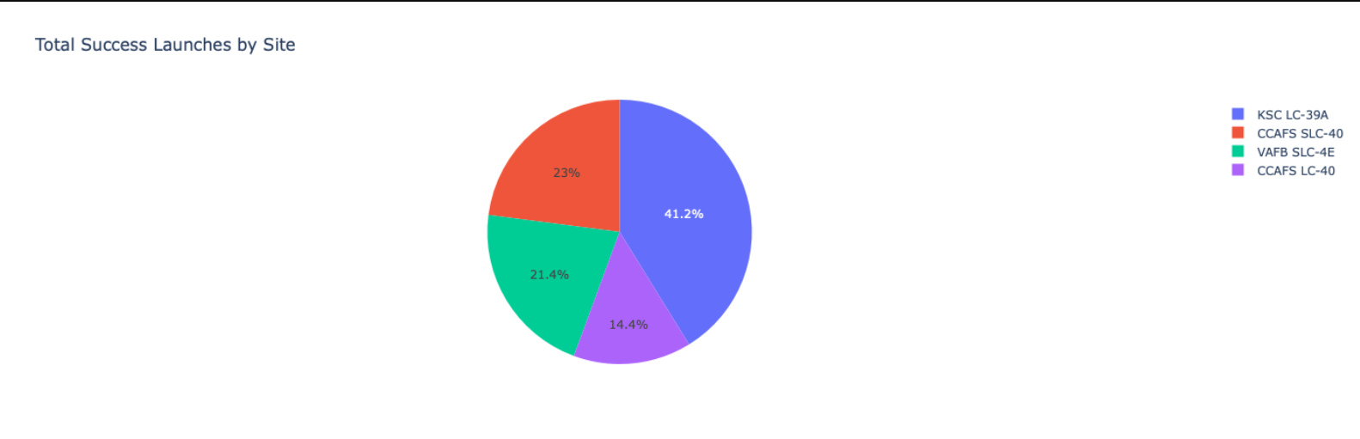
Launch Success
The chart clearly shows that from all the sites, KSC LC-39A has the most successful launches

Slide 39
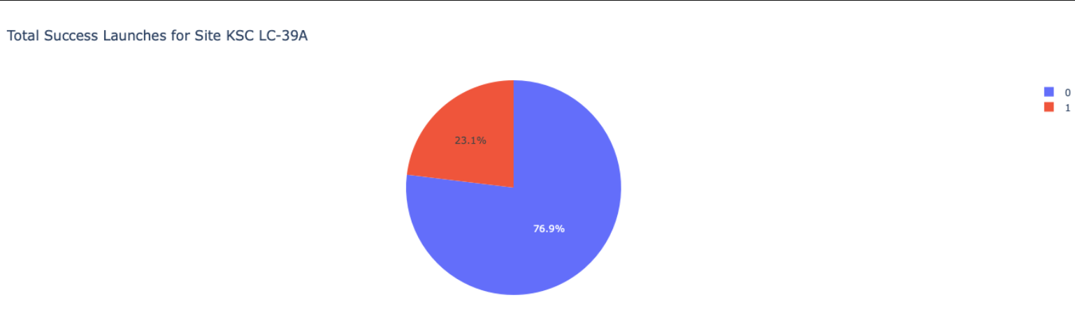
Launch site with highest launch success

Slide 40
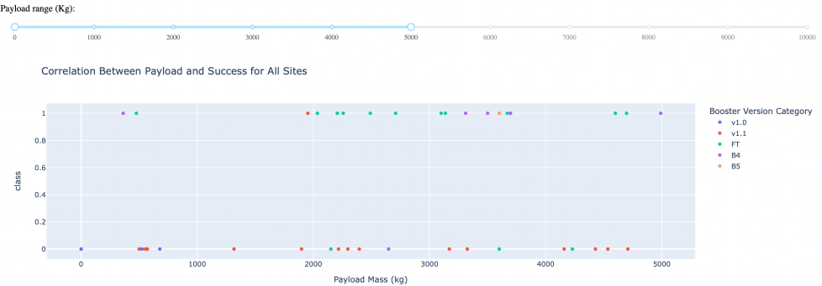
Payload Mass vs. Launch Outcome

Slide 41

Section 5

Slide 42
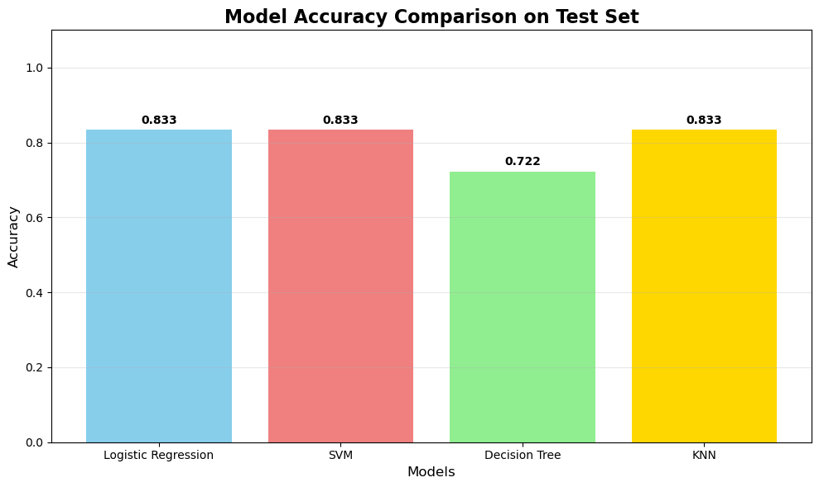
Classification Accuracy
Best Model: Logistic Regression (83.33% Accuracy)
• Interpretability: Clear coefficients show which factors influence landing success
• Efficiency: Fastest training and prediction among all models tested
• Probability Output: Provides confidence levels, not just yes/no predictions

Slide 43
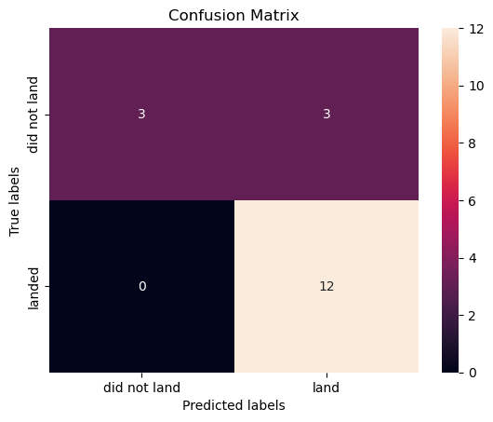
Confusion Matrix
What Actually Happened vs What We Predicted:
Perfect Score on Successful Landings: Our model got it right every single time a rocket actually landed - it never missed one! (0 false negatives)
Some False Alarms: The model got excited and predicted 3 rockets would land when they actually didn't. Think of it like being overly optimistic about landing success.
Great Overall Performance: Out of 18 test cases, the model got 15 correct (83.3% accuracy)

Slide 44
Conclusions
• 83.33% Accuracy: Logistic Regression achieved highest prediction accuracy
• Perfect Landing Detection: Never missed a successful landing (0 false negatives)
• 4 Models Tested: Logistic Regression, SVM, Decision Tree, KNN compared
• Best Choice: Logistic Regression - simple, fast, interpretable
• Conservative Approach: Better to prepare unnecessarily than miss landings
• Cost Savings: Optimizes recovery operations and resource allocation
• Business Ready: Model can be implemented in SpaceX mission planning

Slide 45


